Slide 1
Writing Python Methods
Warren Toomey

Slide 2
Introduction
This week we learn how to write Python methods
Treat a method as a “mini” program
Instead of getting user input, it receives arguments
It has its own variables and blocks of code
which cannot be seen outside of the module
Instead of printing the result, it returns the result
The method has a well-defined interface
Inputs and their types & valid ranges
Result and its type
What the method does on errors

Slide 3
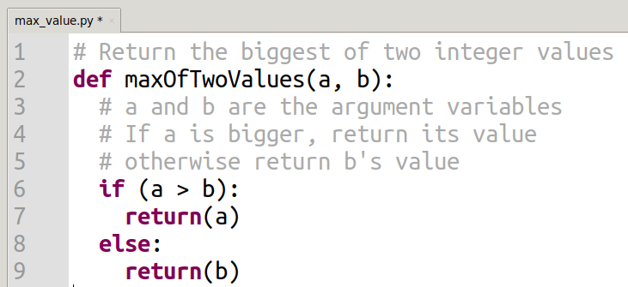
Our First Method: maxOfTwoValues()
Thonny screenshot © University of Tartu

Slide 4
maxOfTwoValues()
The maxOfTwoValues() method is “def”ined
It receives two arguments
Which are stored in variables a and b
There is no return variable
Instead, the return() operation
Stops the execution of the method, and
Returns the value in the parentheses as the answer
There is absolutely NO interaction with the user!!!

Slide 5
maxOfTwoValues()
Type the code into Thonny and try to run it
Nothing happens. Why not?
Thonny screenshot © University of Tartu

Slide 6
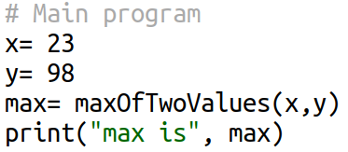
maxOfTwoValues()
We have only typed in the definition of the method
We haven’t tried to actually use it (call the method) yet
At the bottom of your file, add these lines
Now run the program. What is printed?
Thonny screenshot © University of Tartu

Slide 7
Calling a Method
Python starts running the main code
Variables x and y get values 23 and 98
On the line max= maxOfTwoValues(x,y)
Python sees a method call
The main code is stopped
x’s value is copied into the method’s a argument. Ditto, y is copied into b
The value returned by the method is copied into the max variable
The main code is restarted

Slide 8
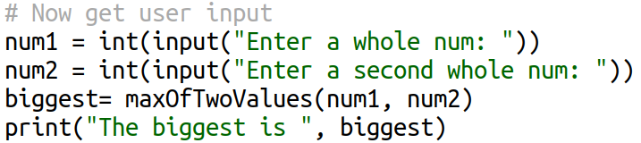
Reusing a Method
Once we have defined a method, we can use it over and over again
Add these lines to the bottom of your code and run the program
Thonny screenshot © University of Tartu

Slide 9
Class Activity
Write the definition of a method that find the biggest of three integer values
What will the interface definition be?
What will the algorithm be?
How can you return all three possible values?
Only write the method for now
Don’t write any code to call it
We will review your implementations

Slide 10
Methods: Notes
As the writer of a method, you get to name it
You also get to choose the names for your arguments
The caller will never see these argument names
Any variables, blocks of code etc. in your method will never be seen by the caller
Your method is a “black box”
If needed, your method can itself call other methods to get the work done
Top-down design: big, smaller, smallest problems

Slide 11
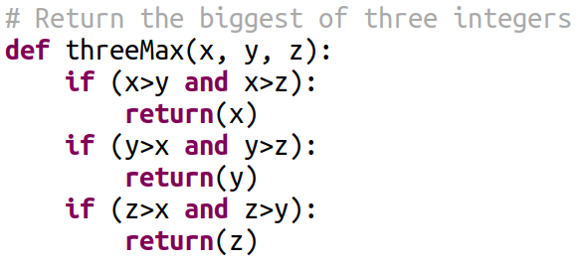
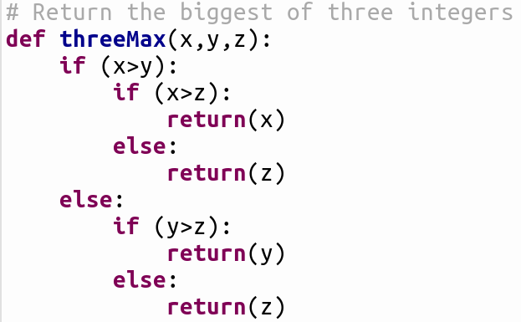
Biggest of Three: Algorithms
Thonny screenshot © University of Tartu

Slide 12
Activity: Calling Your Method
Now write some “main program” code to call your “maximum of three” method
As a caller of a method:
Name of method with parentheses ()
List of argument values in the parentheses
Do something with the returned result

Slide 13
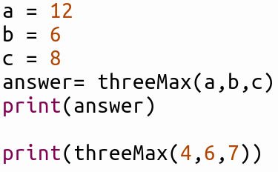
Activity: Calling Your Method
Examples of calling the method
Thonny screenshot © University of Tartu

Slide 14
Activity: Count Uppercase
A method argument can be any Python type
Integer, float, String, Boolean etc.
Ditto the return value
Write a Python method that:
Has one argument, a String
Returns an integer value
Returns the number of uppercase letters in the String
Think:
What will I call the method?
What will the algorithm be?
How do I access each letter in the String in turn?

Slide 15
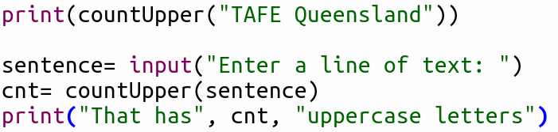
Calling the Method
I called my method: countUpper()
Thonny screenshot © University of Tartu

Slide 16
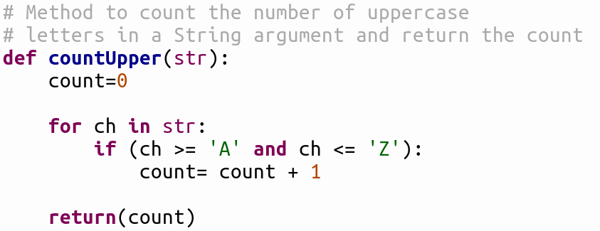
My Method’s Code
Here is my algorithm: linear search
Note: initialise count to zero
FOR loop to access each character
Use of ASCII range to find uppercase
count will have a value regardless of argument
Method has an API comment: important!!!!
Thonny screenshot © University of Tartu

Slide 17
Activity: Compare two Strings
Write a method that takes two String arguments
If they are the same, return True
If not, return False
Write a good API comment before the method definition
Hint: Strings may be of different length
How are you going to deal with this?

Slide 18
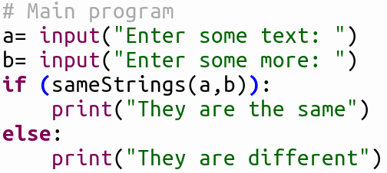
Example Calling of the Method
Thonny screenshot © University of Tartu

Slide 19
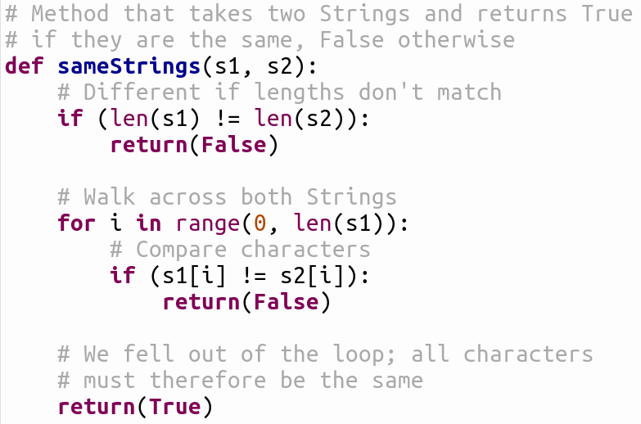
Activity: Compare two Strings
Note the commenting! Very important

Slide 20
Command Line Arguments
You have seen that methods get arguments
Main program: has to use input() to get data
We can also pass arguments to the main program
These will come from the command line
Linux: the shell prompt
Windows: the cmd window

Slide 21
Command Line Arguments
You need to import a Python package:
import sys
The command line arguments are in a list called sys.argv
sys.argv[0] is your script’s name
sys.argv[1] is the first real argument
sys.argv[2] is the second argument etc.
Let’s change the String compare program to get the argument from the command line

Slide 22

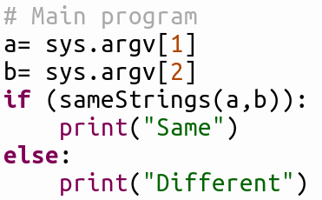
Command Line Arguments
Thonny screenshot © University of Tartu

Slide 23

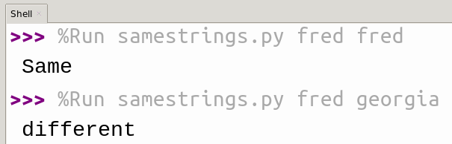
Running the Script from the Command Line
Linux:
Thonny:
Linux screenshot © TAFE Qld
Thonny screenshot © University of Tartu

Slide 24
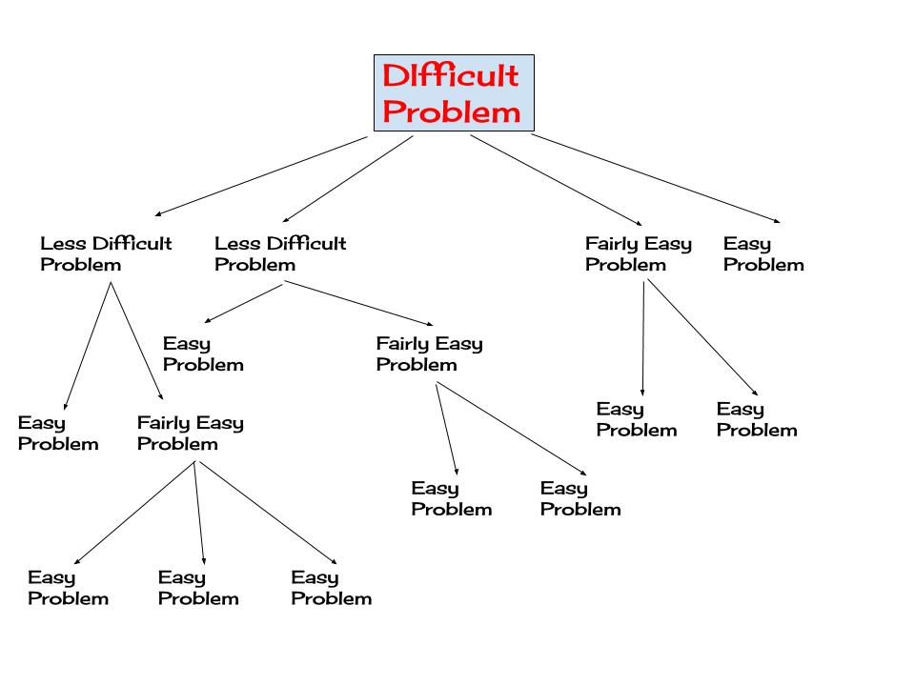
Stepping Back: Why Methods?

Slide 25
Stepping Back: Why Methods?
A module is a self-contained component of a system, which has a well-defined interface to the other components; something is modular if it includes or uses modules which can be interchanged as units without disassembly of the module.
Design, manufacture, repair, etc. of the modules may be complex, but this is not relevant; once the module exists, it can easily be connected to or disconnected from the system.
© Wikipedia

Slide 26
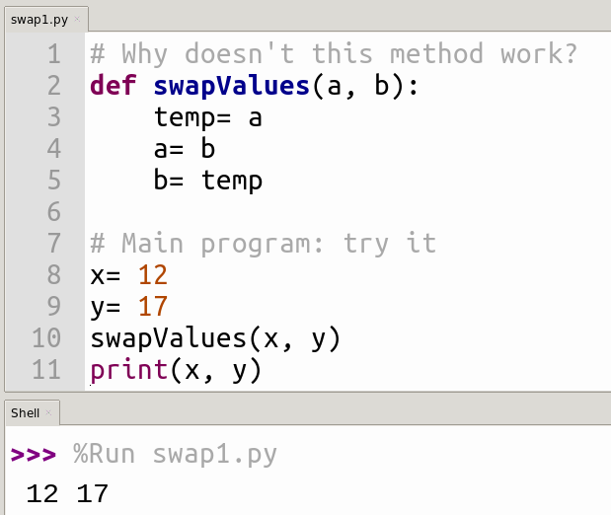
Addendum
Thonny screenshot © University of Tartu

Slide 27
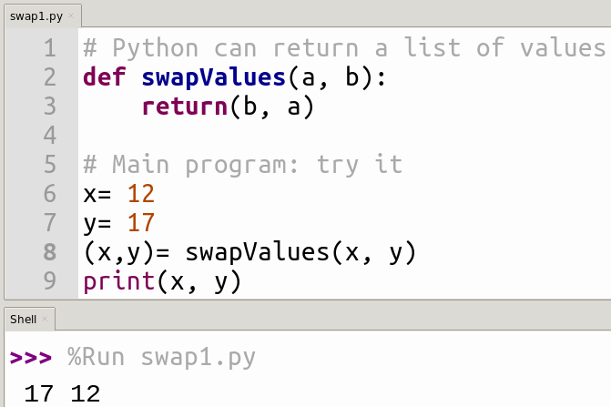
Addendum
Challenge: write method to receive a list of integers, sort them using Bubblesort and return the sorted list
Challenge 2: get the list to sort from the command line, print the sorted list on the screen
Thonny screenshot © University of Tartu

